Slide 1
Welcome!
Mindful Leadership

Slide 2
BEING IN THE ZONE
Notes:
GHIZLANE SIBA gold medal high jumper

Slide 3
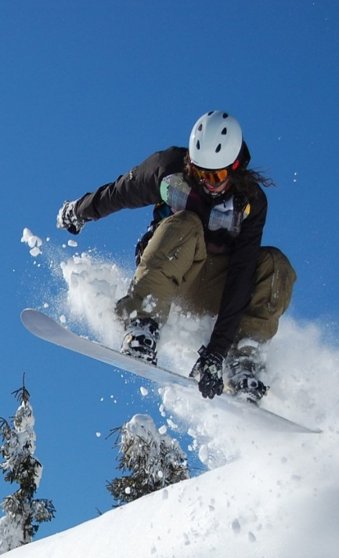
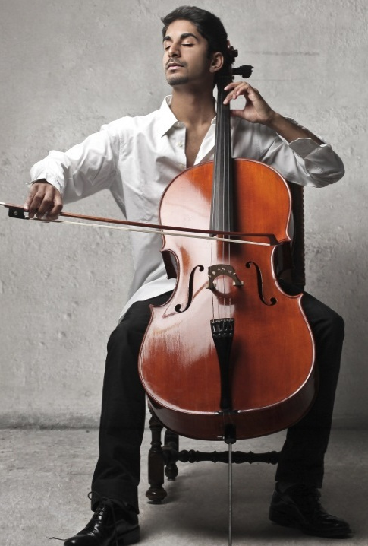
BEING IN THE ZONE
Mental state of operation in which a person performing an activity is fully immersed in a feeling of energized focus, full involvement, and enjoyment in the process of the activity.
Notes:
The concept of “flow” has been studied and named by Mihaly Csikszentmihalyi .
Professor Csikszentmihalyi (Claremont Graduate University) is the founder and co-director of the Quality of Life Research Center (QLRC). The QLRC is a non-profit research institute that studies "positive psychology"; that is, human strengths such as optimism, creativity, intrinsic motivation, and responsibility.
Mihaly Csikszentmihalyi wanted to know what makes people creative. He talked to and collected data about creative people (artists, scientists, musicians, etc.). These people said they were most creative and feel at their best when they were “in flow”. They described flow as an ecstatic state – that is a Greek term meaning the mental state where you feel that you don’t do your normal, daily routine, you are like out of reality. You are fully concentrated on what you do, you don‘t pay attention to anything else, simply because you don‘t have enough attention to spend on something else (like your health or home issues). For example Mihály Csíkszentmihályi said it happens when a musician is playing an instrument, when a scientist is concentrating on a creative process, it happens to sports people, and even CEOs, when they are focused, and passionate about their job.
In positive psychology, Flow is the mental state of operation in which a person performing an activity is fully immersed in a feeling of energized focus, full involvement, and enjoyment in the process of the activity. In essence, flow is characterized by complete absorption in what one does. (Wikipedia)

Slide 4
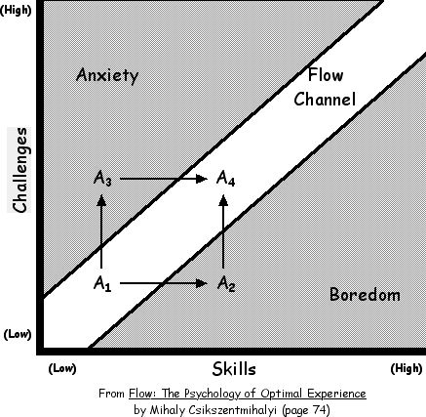
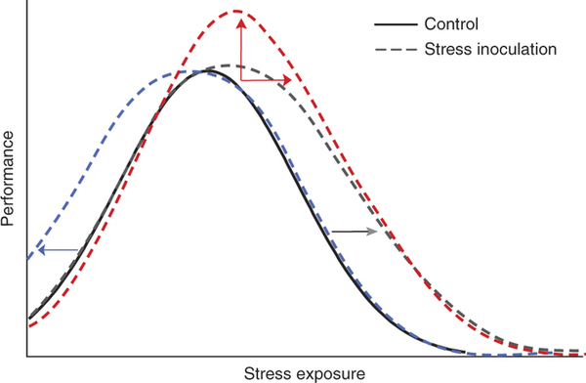
THE ZONE: psychological and neurophisiological views
Neurobiology of Resilience – Nature Neuroscience Review – Russo et al

Slide 5
How does it feel to be «in the zone»?
Completely involved, focused in what we are doing
A sense of ecstasy – of being outside everyday reality
Great inner clarity – knowing what needs to be done, and how well we are doing.
Being willing to enter fully into the activity.
A sense of serenity – a feeling of being beyond the boundaries of self.
Timelessness – thoroughly focused on the present, our subjective perception of time is altered.
Intrinsic motivation – whatever produces flow becomes its own reward.
Source: Mihaly Csikszentmihalyi
Notes:
According to Mihaly Csikszentmihalyi , a state of flow can be characterized by 7 characteristics.
That is basically when you forget about yourself, you feel part of something bigger, you are fully concentrated.
Most people know the experience of flow, and know that flow can happen in everyday life.
You can ask participants to share some example and share some yourself (for example when you take the time to immerse yourself on a specific topic and work on it for a few hours, there is usually a moment where you are fully engaged, see things more clearly and start to make connections, have new ideas etc.)

Slide 6
The ZONE is well known in sport and the arts
Direct feedback from the body and the environment on reaching set goals
Strong feeling of focus/non distraction
Production of serotonin and endorphins
Strengthens feeling of confidence and power
Time out from stress
Synchronization of body and mind

Slide 7
The ZONE is well known in sport and the arts
Athletes, artists and others describe it as a creative, productive state of being:
The flow experience is possible in many aspects of life.
It is an expression of non-distracted absorption in what we are doing.
It results naturally from the synchronization of body and mind.

Slide 8
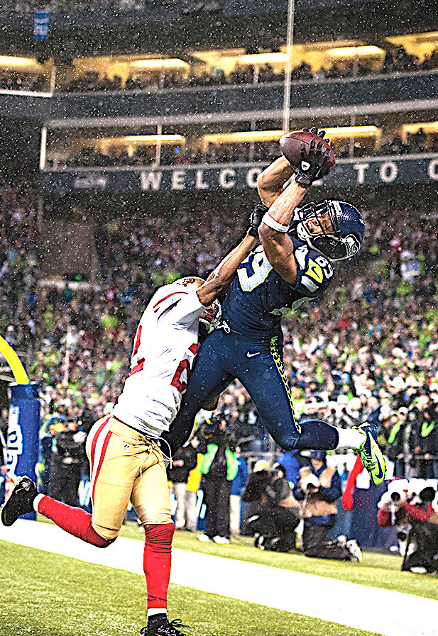
How Mindfulness Won the Super Bowl
Days after the Seattle Seahawks won the Super Bowl in a nearly flawless performance, we're left wondering, "How'd they do it?”
Head coach Pete Carroll hired a sports psychologist to to teach team members mindfulness, with its proven ability to increase happiness and decrease stress.
In addition, research is showing the benefits of being "in the zone,” a state of consciousness where one is fully engaged in an activity without mental commentary.

Slide 9
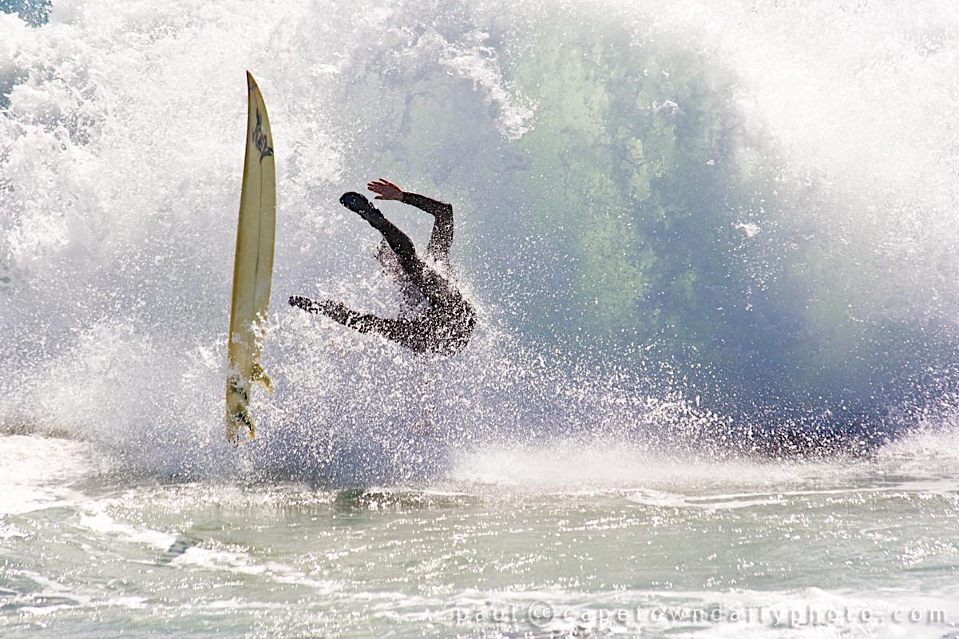
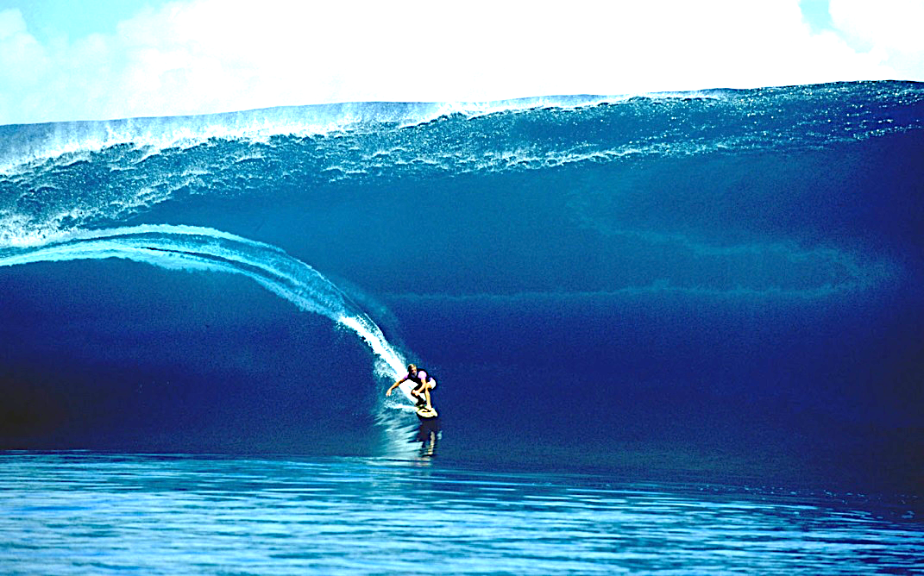
To surf in the zone we have to mindful!

Slide 10
You can create the conditions for flow in your working life
Take a pause – the “one minute experiment“ or other practice
Reduce interruptions. Turn off electronic distractions (phone, emails, chats.)
Check your inner dialogue and emotional state
Set a limited goal for what you want to achieve
Work in a focused manner. If need, be make a “follow up“ list for later
Keep track of progress
Make space (physical space, space in our schedules)
Celebrate success

Slide 11
CONVERSATION
In groups:
Please share experiences you have had or know about where you or others have experienced “being in the zone”.
Do you think it would be possible to create the conditions yourself to feel that same level of engagement and creativity?

