Slide 1

Welcome!
Mindful Leadership

Slide 2
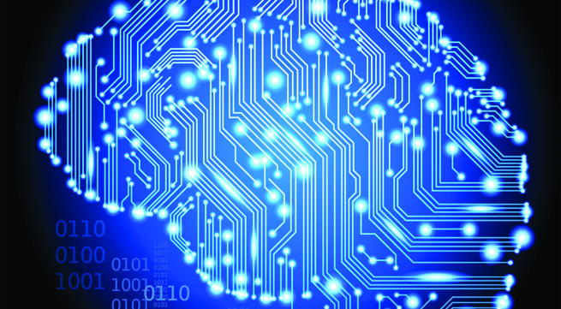
OUR BRAINS CHANGE

Slide 3
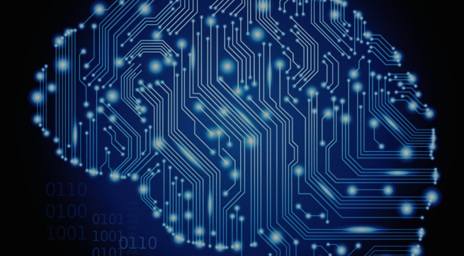
OUR BRAINS CHANGE
NEUROPLASTICITY

Slide 4
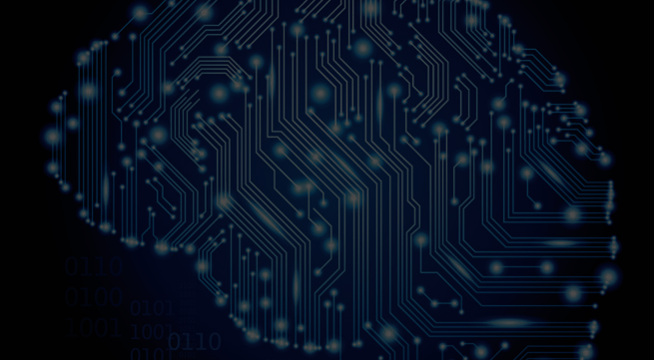
OUR BRAINS CHANGE
NEURO PLASTICITY

Slide 5

OUR BRAINS CHANGE
NEURO PLASTICITY

Slide 6
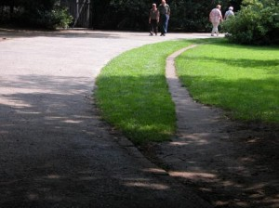
New pathways are always being created
  New networks of neurons are being created.
  Some networks are being strengthened.
  Some are being neglected.
  Some are being erased.
Notes:
. Until recently, it was believed that the human brain, could not generate new neurons. The old model assumed that each of us was born with a finite number of neural cells and when a cell died no new cell could grow. It has now been proven that certain areas in the brain can generate fresh cells.
2. Another misconception was that the brain had an inability to create new neural pathways. This old theory thought our ability to generate new pathways dropped off sharply around the age of 20, and then became permanently fixed around the age of 40. New studies have shown through the use PET, and MRI brain scanning technology, that new neural cells are generated throughout life as well as new neural pathways. Even the elderly are capable of creating measurable changes in brain organization. Concretely this means that new connections between neurons, new synapses are created.
That is what we call the neuroplasticity of the brain: we can create new synapses and new neurons can be generated.
Neural integration connects neurons together, and neuroplasticity allows us to change these connections.
This neuroplasticity of the brain is something that our brain naturally does in case of problem, to help us regain balance. It helps us to regain control over ourselves when a part of ourselves does not work properly anymore. As an example, each part of our body is “mapped”, controlled by a specific part of our brain. Let’s imagine that after a serious accident you lose part one of your cheek, and the surgeon uses part of your shoulder to rebuild your face. Your brain will have to re-map that new part of your face coming from your shoulder to the part of your brain that allows you to smile. Otherwise when you try to smile you will activate the part of your brain which is making your shoulders moves...
There is also another way our brain creates new connections:
In the last century, the psychologist Donald Hebb (1904 -1985) said that “neuron that fire together wire together”. When you do something on a repetitive basis, when you always use you mind in the same way, you create new pathways in your mind. For example, it has been shown that when teenagers are always using their mobile phone, the part of the brain controlling finger movements gets bigger.
“Perhaps your mind is running themes of threat, grievance or loss, perhaps it is running generosity, kindness, awakening. Whichever movie we are running, the neurons are firing and wiring together.” (Mind Changing Brain Changing Mind – Rick Hanson)
What we pay attention to is important because it impacts our brain.

Slide 7

Neuroplasticity

Slide 8
Neuroplasticity
CONVERSATION

Slide 9
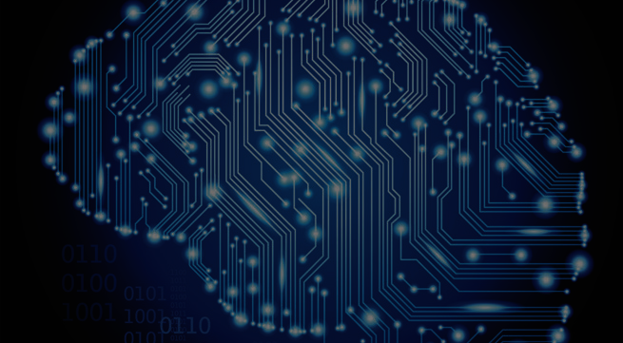
Conversation
Can you think of any change
in your habits or your way of thinking that you have gone through
in your own life?

