Slide 1
Welcome!
Mindful Leadership

Slide 2
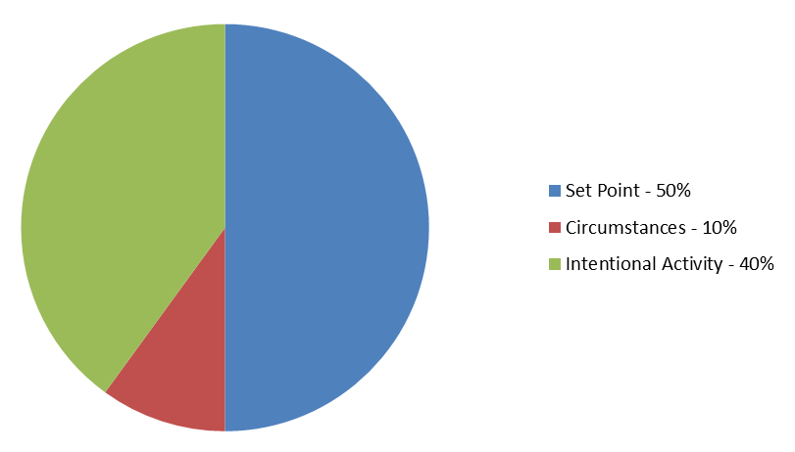
Mental states relatively independent of outside factors
FACTORS
Notes: SET Point refers to genetic factors, basic make-up at birth: Source: Sonja Lyubomirsky
Notes:
Sonja Lyubomirsky (psychologist , Professor at University of California) suggests that
50% of happiness is genetically predetermined
10% is due to life circumstances
40% is the result of your own personal outlook
A groundbreaking study in the 1990s came to the following conclusion:
“Happiness, or subjective well-being, was measured on a birth-record based sample of several thousand middle-aged twins using the Well-Being scale of the Multidimensional Personality Questionnaire. Neither socioeconomic status, educational attainment, family income, marital status, nor an indicant of religious commitment could account for more than about 3% of the variance in Well-Being...From 44% to 52% of the variance in WB, however, is associated with genetic variation” (Happiness is a Stochastic Phenomenon, David Lykken and Auke Tallegen, University of Minnesota)
Based on this research, Psychologist Sonja Lyubomirsky suggests that
50% percent of happiness is genetically predetermined
10% is due to life circumstances
40% percent is the result of your own personal outlook
A lot of research suggests that people have a “genetic set point”, that means a certain range/point of happiness which is genetically inherited, just like people tend to revert, despite dieting, to a certain body weight. It has been shown that even after a big lottery win, a year later the winner will revert to their level of sadness or happiness that was their natural lot before the windfall.
However, Lyubomirsky does argue that despite a certain “set point” one might possess, there is always room for improvement. We are not entirely subject to our genetic programming. Our genes do not determine our life experience and behavior. Our experience and behaviors can modify our happiness level.
Martin Seligman also believes that you increase your happiness in the upper reach of your natural range.

Slide 3
Mental states relatively independent of outside factors
Genetic Factors at Birth
External Circumstances
Intentional Activity

Slide 4
States of mind affect performance
Negative states: fear
Positive states: engaged
Cognitive abilities
Fewer new ideas
Retreat/rejection
Perceptual mistakes
Tunnel vision
Cognitive abilities
More insights
More alternatives
More engagement
Fewer perceptual mistakes
More activity in brain stem
Relying on established patterns
Less activity in brain stem
More conscious decision making
Focus on self, survival, defense
Broader focus on others, the whole
Taking responsibility
Source: David Rock – the Neuroscience of Engagement
Notes:
Quotes from David Rock:
For example, in the reward state, versus the threat state, people:
experience increased cognitive resources (Arnsten, 1998)
Are generally more creative (Friedman and Förster, 2001)
• solve more problems with the insight phenomenon,
which is required for complex problem solving (Jung-Beeman et.al 2009)
• Come up with more ideas for actions (Frederickson, 2001)
• Have a wider field of perceptual view (schmitz, De Rosa and Anderson, 2009

Slide 5
Do states of mind have an impact?
Mouse and cheese
Mouse and owl

Slide 6
Differential in creativity and problem solving
50%

Slide 7
Does Mindfulness have an impact?
Satisfaction
Relationships & Work
Insight
Appreciating the moment
Being conscious of our sense perceptions
Relaxing and being open
Being present with others
Responding with emotional intelligence
Avoiding multi-tasking and fragmentation
Reducing stress
Reflecting
Taking time to think
Acting purposefully
and effectively
Notes:
Mann könnte auch hier ein Peil (Links nach Rechts) visualisieren und zwar „der grad der Nachhaltigkeit order „Un-störbarkeit der Freude.
Manche sagen alle echte Freude is Unbedingt und dafür un-störbar

Slide 8
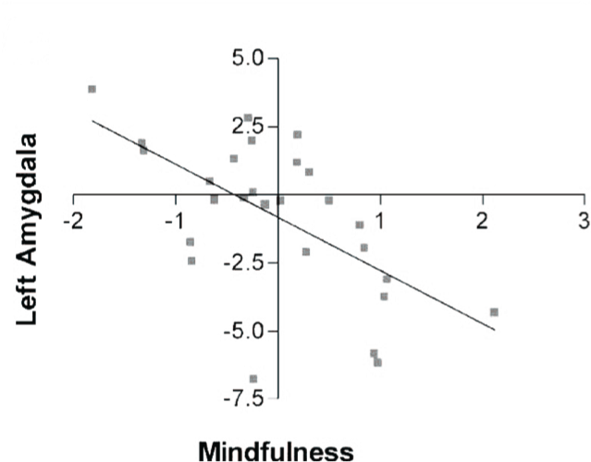
Mindfulness reduces the activation of the amygdala in response to negative stimuli
Mindfulness and regulation of amygdala
http://www.ncbi.nlm.nih.gov/pubmed/21679770
Notes:
We report for the first time significant increases in left-sided anterior activation, a pattern previously associated with positive affect, in the meditators compared with the nonmeditators. We also found significant increases in antibody titers to influenza vaccine among subjects in the meditation compared with those in the wait-list control group. Finally, the magnitude of increase in left-sided activation predicted the magnitude of antibody titer rise to the vaccine. http://www.ncbi.nlm.nih.gov/pubmed/12883106
The present findings with a dispositional measure of mindfulness suggest one potential neurocognitive mechanism for understanding how mindfulness meditation interventions reduce negative affect and improve health outcomes, showing that mindfulness is associated with enhanced prefrontal cortical regulation of affect through labeling of negative affective stimuli. http://www.ncbi.nlm.nih.gov/pubmed/17634566
Experiential and Narrative self-focus conditions in the novice (pre MT) group. (A) Areas of greater association with the Narrative condition (Narrative > Experiential) are in blue, and (B) areas of greater association with the Experiential condition ...
http://www.ncbi.nlm.nih.gov/pmc/articles/PMC2566754/
On the other hand, for beginners relative to experienced meditators, mindfulness induced a down-regulation of the left amygdala during emotional processing. These findings suggest that the long-term practice of mindfulness leads to emotional stability by promoting acceptance of emotional states and enhanced present-moment awareness, rather than by eliciting control over low-level affective cerebral systems from higher-order cortical brain regions. These results have implications for affect-related psychological disorders.

Slide 9
Expansive mindfulness WIDE OPEN Awareness
The Practice of Aimless Wandering

Slide 10
Wide open awareness

Slide 11
Conversation: AIMLESS WANDERING
Notes:
Ask participants a number of questions:
How did time feel like.
What did they notice?
What did they notice about other people around them? What was their posture? Did they generally have their gaze down or at least closed? Maybe their noticed how much people scurry around with their head down.
What happened when the noticed their own senses? What happened to thinking? (opening senses activates our direct experience network and downregulates the narrative network)

