Slide 1
Assessing your mindfulness
ATTENTION NETWORK TEST

Slide 2
Three networks
Alerting
Orientation
Executive Control

Slide 3
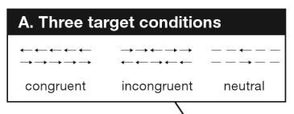
The Attention Network Test
Executive Control Network

Slide 4
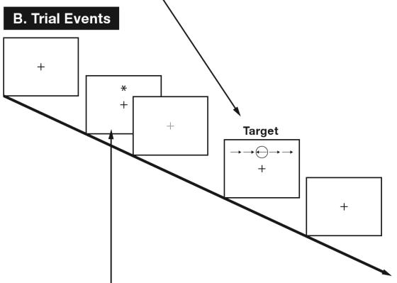
The Attention Network Test

Slide 5
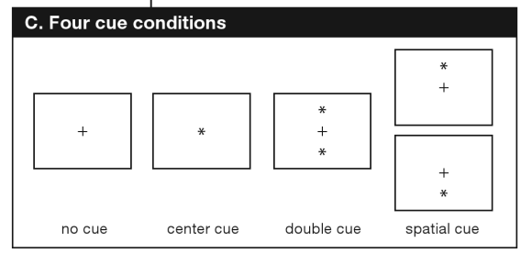
The Attention Network Test

Slide 6
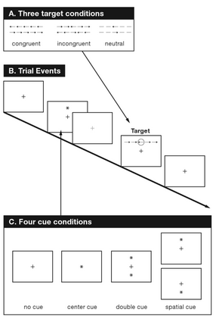
Attention Network Test

Slide 7
Measuring Network Efficiency
ANT measures the efficiency of our ability to:
Be aware of something happening and turn our attention to it (Alerting Network)
Place a new event in context (Orienting Network)
Plan what do do about it (Executive Control Network)
Assesses these abilities at high speed (480 – 700 milliseconds)

Slide 8
The Attention Network Test
Alerting network is measured by the time difference between responses when there is a prompt and no prompt.
Orienting network is measured by the time difference between responses when there is an orienting cue (up or down) and no cue.
Executive control network is measured by the time difference between responses when there are conflicting flankers and when not.

Slide 9
Mindfulness and network efficiency
“In general, anxiety inhibits attentional control on a
specific task by impairing processing efficiency. . . . Even
four days of mindfulness training can significantly improve
visuo-spatial processing, working memory and
and executive functioning.”
“Probing the Mechanisms of Attention,” Posner, Rueda & Kanske; The Handbook of Psychology, Cambridge University Press, 2007

Slide 10
Alerting network is measured by the time difference between responses when there is a prompt and no prompt. Orienting network is measured by the time difference between responses when there is an orienting cue (up or down) and no cue. Executive control network is measured by the time difference between responses when there are conflicting flankers and when not..

