Slide 1
WHAT DOES MINDFULNESS MEAN?
WHAT DOES MINDFULNESS MEAN?

Slide 2
BEING
FULLY
PRESENT

Slide 3
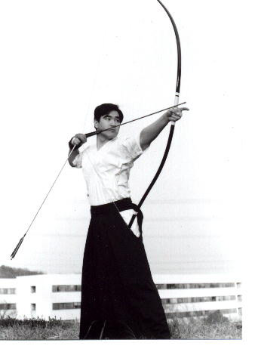
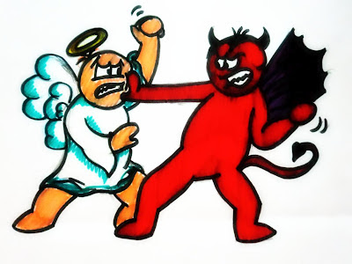
A central and basic ability of mind
On purpose
Present moment
Non judgmental
Mind
Heart
Body
.
Notes:
I am conscious of my intention to be in the present moment, to focus on the object of attention
In the present moment my body, emotions/heart and mind are all synchronised – aligned. Often the emotions are ignored, the mind is elsewhere and the body is not felt
We do this without judgement – simply seeing what we see – opens up greater awareness, sensitivity and insight

Slide 4
EXPLORing our attention
Notes:
Sit upright
Direct your attention to the room or something in the rooom
Stay with that
Ask what people experienced – ask them to talk to each other. Talk about experience. Don‘t judge, just listen to what the other person experienced.
All this experience is welcome

Slide 5
Conversation

Slide 6
WHAT WAS YOUR
EXPERIENCE
IN THE
TWO MINUTES?

